Slide 1
Time Travel
Anchal Gupta
Sindhu Thumati

Slide 2
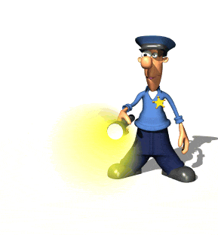
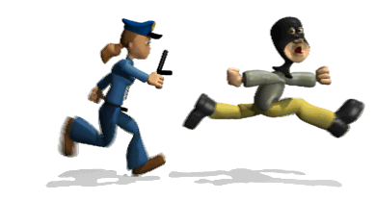
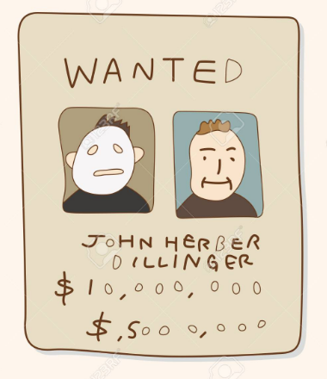

Police Chasing a thief
2 years later Still searching
The thief escaped. Let me publish a wanted notice

Slide 3
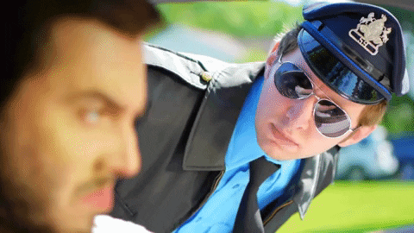
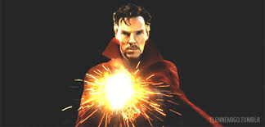
Cop Encounters thief after 5 years
Failed to recognize the thief because the thief is now aged and looks different
Very expensive
Police meets doctor strange to get current image of the thief

Slide 4

Police comes to Penn State Great Valley For Solutions
Anchal and Sindhu will help the police with their “Time Travel” Product

Slide 5
Context and Problem
Face progression and regression has tremendous impact to a wide-range of applications like face prediction of missing/wanted people, entertainment, etc.
But major challenge in this area of research come from the rigid requirement to the training and testing datasets, as well as the large variation presented in the face image in terms of expression, pose, resolution, illumination, and occlusion.
In this paper, we investigate the age progression/regression problem from the perspective of generative modeling.

Slide 6
State of Art
Models like CNN does not preserve the personality feature
Also, they require age labels to be associated with the dataset.
It requires large dataset to be trained.
The pictures can have different expression, pose and illumination

Slide 7
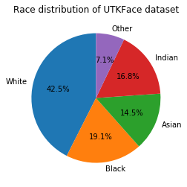
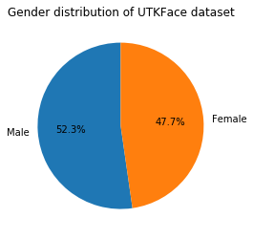
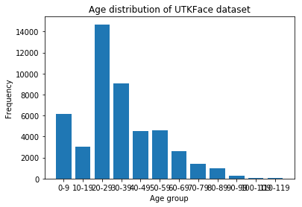
Data collecting and Preprocessing, training / testing datasets
Data Source – Kaggle
Data Description – 23,705 Images of different resolutions
Deleted images with no missing age label
Grouped the age into ten categories, i.e., 0–5, 6–10, 11–15, 16–20, 21–30, 31–40, 41–50, 51–60, 61– 70, and 71–80.
Training on entire dataset

Slide 8
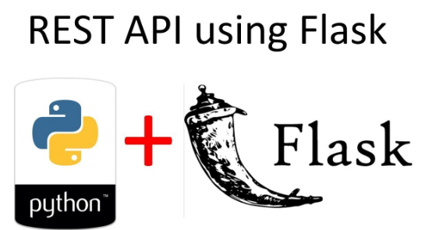
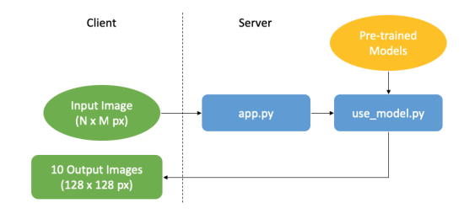
Client Server Architecture
On the client side, users will have the option to select an input image by browsing their computer.
Once an image is submitted, a GET request is sent to the API back-end which calls use model to pre-process the input image.
The new image is then passed to the pre-trained models to generate the 10 images that are displayed on the client side for users to observe

Slide 9
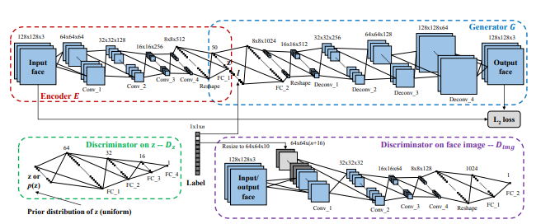
Methodology
Conditional Adversarial Auto Encoder:
Generative Adversarial Networks simultaneously train two models
1) the generative model G captures the distribution of training samples and learns to generate new samples imitating the training
2) the discriminative model D discriminates the generated samples from the training.

Slide 10
Encoder
INPUT
128x128x3
Conv1
64x64x64
ReLU
Conv2
32x32x128
ReLU
Conv3
16x16x256
ReLU
Conv4
8x8x512
Fully connected Layer
32768x50
Ouput
Latent vector
50x1
Convolutional Neural Network
4 Convolution Layers
Relu Activation Functions
1 Fully Connected Layer

Slide 11
Generator
INPUT
Concatenated Vector of latent Vector ,one hot encoding age and gender
DeConv1
16x16x512
ReLU
DeConv2
32x32x256
ReLU
DeConv3 64x64x128
ReLU
DeConv4
128x128x64
Output
128x128x3
De-Convolutional Neural Network
4 De-Convolution Layers
Relu Activation Functions

Slide 12
Discriminator on face image
INPUT
128x128x3
Conv1
64x64x10
ReLU
Conv2
32x32x32
ReLU
Conv3 16x16x64
ReLU
Conv4
8x8x128
Fully connected Layer 1
8192x1024
Output
1024x1

Slide 13
Discriminator on Encoder(latent vector)
INPUT
(50x64)
FC1+Batch Norm
ReLU
FC2+Batch Norm 64x32
ReLU
FC3+Batch Norm 32x16
ReLU
Output
16x1
Simple Neural Network
3 Linear Layers
Relu Activation Functions

Slide 14
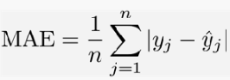
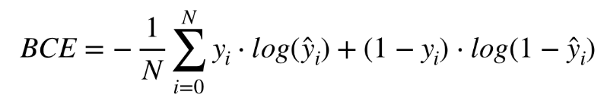
Loss Functions
Encoder and Generator Loss – EG
Discriminator on Encoder – Dz
Discriminator on Generator– Di

Slide 15
Hyperparameter Tuning
Learning Rate - 0.001 and 0.0002
Optimizers – Gradient Descent and Adam(B1-0.5 and B2-0.99)
Normalization – Batch Normalization on Discriminators
Mini Batch Size – 32 and 100
Epochs – 25 and 50

Slide 16
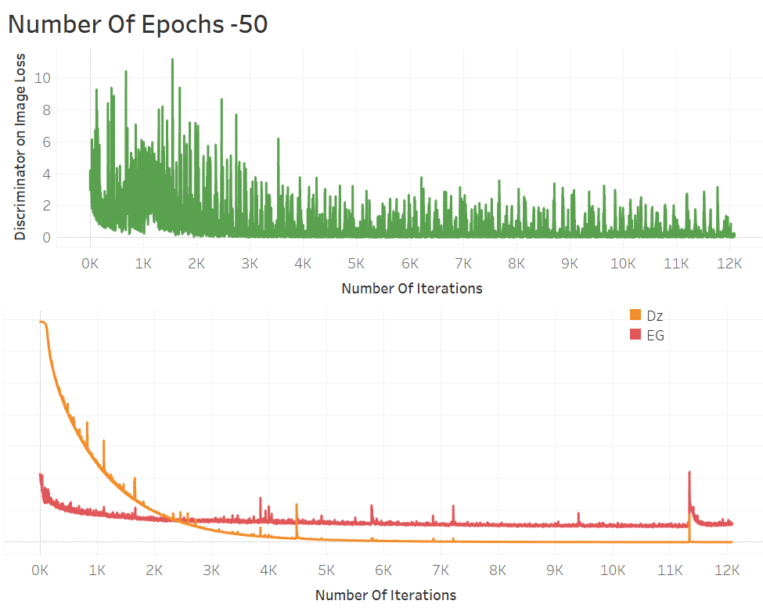
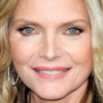
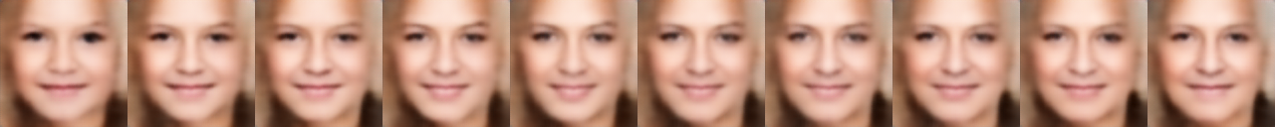
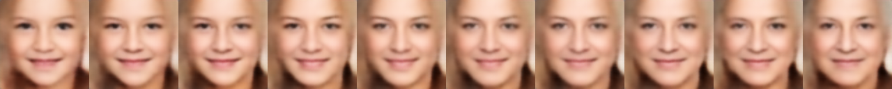
25 epochs
50 epochs

Slide 17
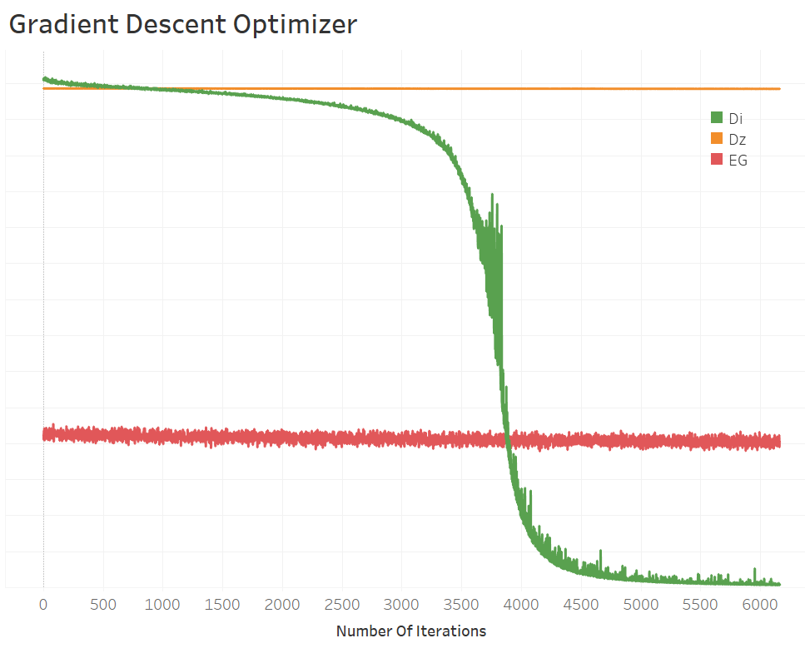


Slide 18
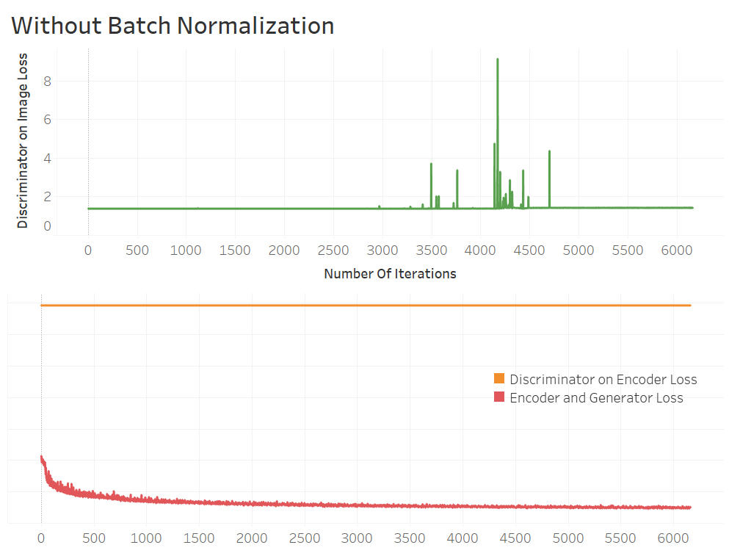
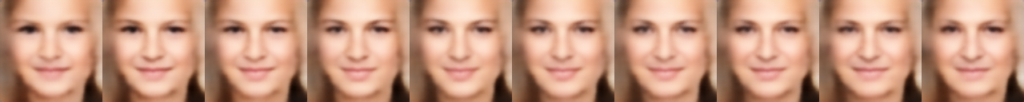

Slide 19
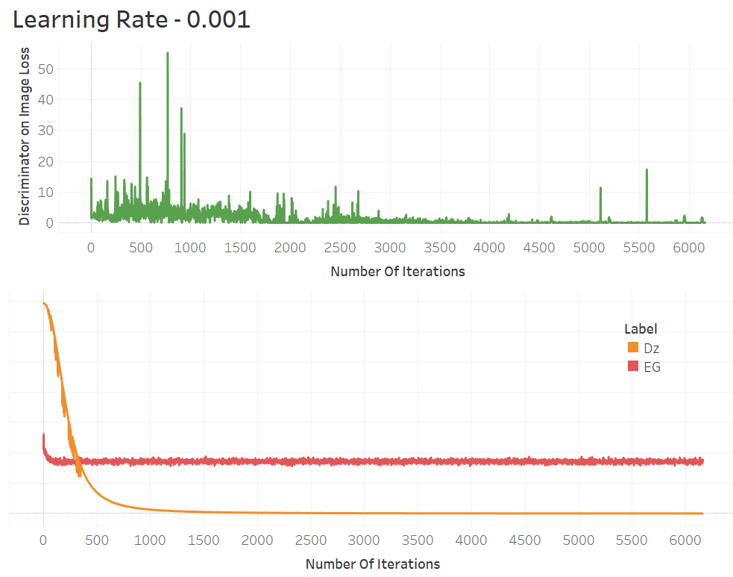
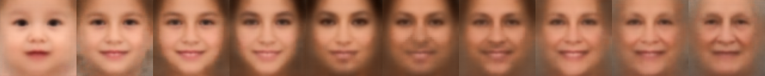

Slide 20
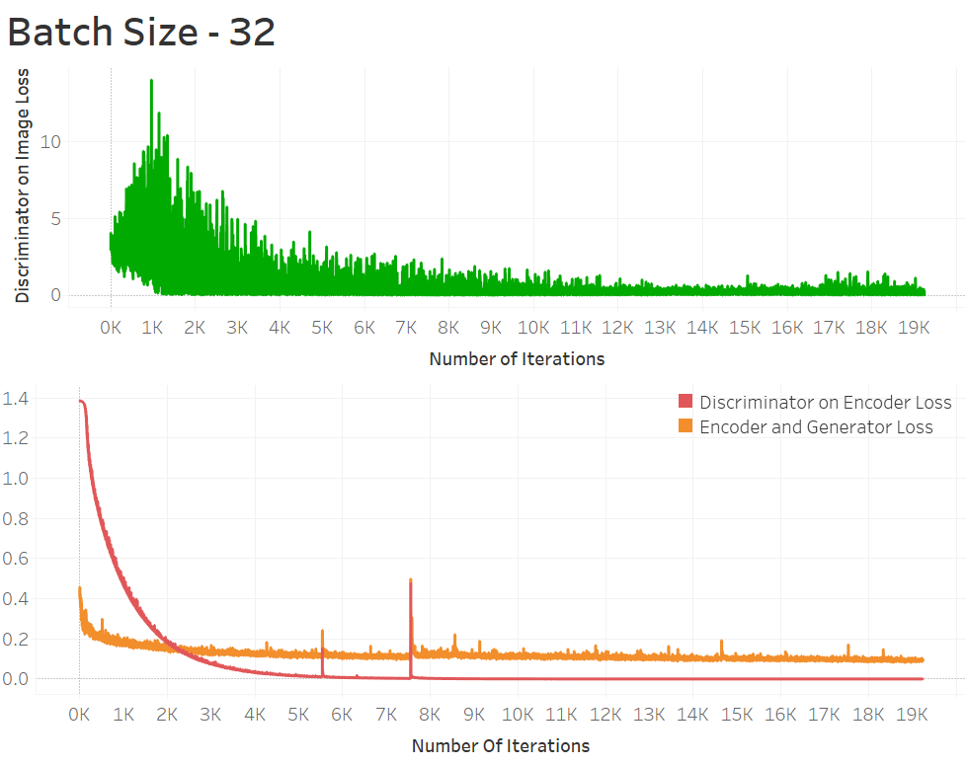
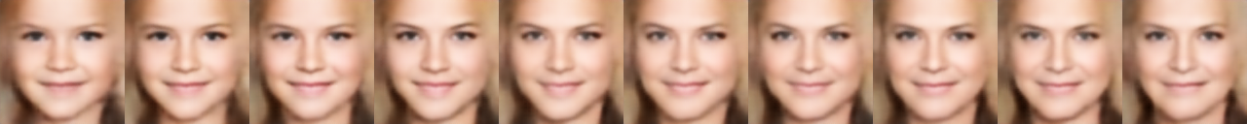

Slide 21
Outcomes/finding
Implemented Model performs best for below parameters:
Learning Rate – 0.0002
Batch Size – 32
Optimizer – Adam
Epochs - 50

Slide 22
Lessons learned and Perspectives
Technologies-
Google Cloud Computing
TensorFlow
Flask
Lessons –
Start Training Model as soon as possible – 10 hours for 1 model even on GPU
Save intermediate Models
Further Improvements-
Collection if more data with diverse races
Testing on more hyperparameters

Slide 23
Demo !
http://localhost:5000/

Slide 24


